Slide 1
Office of Academic Affairs
Promotion on Teaching for Clinical Faculty
IUPUI

Slide 2
View Previous Workshops
https://academicaffairs.iupui.edu/Faculty-Affairs/promotiontenure/workshops/

Slide 3
Welcome
Willie Miller
Faculty Advancement and Leadership Development Fellow
Rachel Applegate
Assistant Vice Chancellor for Faculty Affairs
Margie Ferguson
Senior Associate Vice Chancellor for Academic Affairs

Slide 4
Agenda
Teaching at IU and IUPUI
Developing Excellence in Teaching
Defining Excellence
Documenting Excellence in Teaching
eDossier

Slide 5
Teaching at IU and IUPUI

Slide 6
Why do I talk about teaching in general to start with?
To describe the mindset and assumptions of reviewers of your case.
They are familiar with teaching expectations for ALL IUPUI faculty.
If your statement and documentation do not rise above this all-faculty level, they will not see you, review you, assess you, as ”excellent.”

Slide 7
Satisfactory in Teaching (All Faculty)
Promotion and Tenure Guidelines , pg. 18
(Except research scientists)
Compliance with program, campus, and university policies (e.g. at least minimal use of Canvas, grading rosters, office hours, and responsiveness to questions)
Participation in program learning infrastructure (assessment of student learning, the Record, student engagement roster, etc.)
Evidence of student learning
Student input about teaching (course evaluations)
Peer reviews of teaching
Peer=other teaching faculty in your unit

Slide 8
Most reviewers of clinical cases:
Are more familiar with research as an area of excellence (for tenure-track)
Are more familiar with service as an area of excellence (for Medicine clinical)
Therefore, they are most used to assessing teaching as satisfactory
Notes:
You case for excellence has to look like more than they are used to seeing about teaching.

Slide 9
Excellence in Teaching always includes:
Reflection on and improvement of own teaching
Sources of information: student evaluations, peer evaluations, professional development, and course/learning data
Evidence of extraordinary student learning
External peer evaluation of teaching activities
Dissemination of scholarship [of teaching] (for tenure track all ranks, clinical all ranks, and teaching professor for lecturer ranks.)
Sophisticated teaching philosophy
Notes:
Our P&T guidelines identify these as required evidence in establishing a case for excellence in teaching. Excellence in teaching is more formative and reflective than a research case. You might have mentors who went up on research. Their cases featured summative statements. A teaching case tells a story about how you got so great and will continue to be great.

Slide 10
Excellence for Clinical track faculty:
Dissemination (beyond department/school) in an appropriate peer-reviewed format
For full clinical: national-level dissemination
All evaluators are external to IUPUI (up to 2 may be other IU or PU campuses)

Slide 11
Scholarship in Support of Teaching
Lecturer and clinical faculty may present products of scholarly activity as part of a case for excellence in teaching, on condition that they discuss and demonstrate how those activities support teaching.
No product may be labelled as “research” (per IU policy) but they may be listed in the ‘teaching’ section of a IUPUI P&T CV.
Clinical faculty whose scholarship supports their service are likely to use service as an area of excellence.

Slide 12
Current Guidelines
Clinical faculty must have disseminated scholarship. This scholarship need not address pedagogical theory or techniques. The candidate must demonstrate how the scholarship supports their teaching and their case for teaching excellence. (pg. 28, Campus P&T Guidelines 2023-24)

Slide 13
Developing Excellence in Teaching

Slide 14
Center for Teaching and Learning
Events/workshops/resources
Center for Teaching and Learning
https://ctl.iupui.edu/Workshops-Events/Events/EventListing
General IU resources:
Teaching.iu.edu
Teachingonline.iu.edu

Slide 15
More resources: The Forum
theforum.iupui.edu

Slide 16
Accreditation and teaching documentation
A key element of promotion dossiers is evidence of student learning
For promotion: “Evidence that courses taught contribute to the overall student learning outcomes specified by the unit and evidence that students have met or exceeded course or curricular learning objectives should be provided.” IUPUI guidelines p. 43
A key element of accreditation requirements is evidence of student learning.
“Require institutions or programs to establish and make public their expectations for achievement of academic quality and indicators of student success, to implement processes to determine whether students and graduates meet the stated expectations and to make public, in aggregate form, evidence of student success.” Standards for Accrediting Organizations, Council on Higher Education Accreditation
THEREFORE: Take advantage of your unit’s assessment reporting. Check unit PRAC reports.

Slide 17
Defining Excellence in Teaching

Slide 18
Excellence in Teaching
From: IUPUI Promotion and Tenure Guidelines
Sophisticated teaching philosophy - reflective, innovative, evolved over time
Discussion of approach, methodology, goals and their achievement
Teaching innovation, curricular development, incorporation of new technology
More on documenting this in a bit.

Slide 19
Excellence in Teaching
From: IUPUI Promotion and Tenure Guidelines
Record of nationally and/or internationally disseminated, peer-reviewed scholarship
Documented by peer/student evaluation over time
Information on teaching load
Evidence of impact on student performance and learning outcomes
Teaching awards or significant funding for teaching projects
More on documenting this in a bit.

Slide 20
Suggested Standards of Evaluation
Category | Excellence
Instruction REQUIRED FOR ALL | Documentation of extraordinarily successful teaching and learning outcomes; the case for teaching excellence is grounded in a sophisticated teaching philosophy; evidence of innovative and reflective teaching practice.
SOME OF THE FOLLOWING
Course or Curricular Development | In addition to producing effective course and curricular products, shows evidence of having disseminated ideas within the profession or generally through publication, presentation or other means. Evidence that the work has been adopted by others (locally and nationally) indicates excellence.
Mentoring and Advising | Mentoring and advising characterized by scholarly approach; high accomplishments of students mentored or advised consistently linked to influence of mentor. Scholarly and reflective approach to mentoring and advising documented; demonstrated impact on accomplishments of mentored and advised students. External peer review clearly demonstrates the attributes of scholarly work associated with mentoring or advising, including peer refereed presentations and publications and national recognition of the quality of work.
From: IUPUI Promotion and Tenure Guidelines

Slide 21
Suggested Standards of Evaluation
Category | Excellence
Scholarly Activities Including Awards | Documentation of a program of scholarly work that has contributed to knowledge and improved the work of others through appropriate dissemination channels. Positive departmental evaluations on the stature of the published work (e.g., journals). Peer review supporting the quality of the publications, presentations or other dissemination methods. National or international teaching awards or significant funding for teaching projects. Some level of national peer-reviewed dissemination of scholarship is required to document excellence for clinical and tenure track faculty.
Professional Development Efforts in Teaching | Extensive record of participation in experimentation, reflection, pursuit of conceptual and practical knowledge of teaching and learning. Membership in communities of practice on the campus, national, or international level. Participation in dissemination of good practice. Peer review of efforts and impact of candidate’s work in this area.

Slide 22
Development and achievement
Especially for teaching excellence, you should demonstrate not only static achievements, but describe your continuing improvement.
Early | Mid | Final
Attend workshop | CTL review of applying workshop ideas | Presenting at a workshop/conference
Create syllabus | Peer review and student evaluation → design changes | Evidence of student learning achievement
Initial teaching philosophy | Reflection on teaching experiences | Teaching philosophy that addresses your growth and has plans for the future

Slide 23
Peer-reviewed dissemination
Campus requires that clinical faculty seeking any level of promotion have peer-reviewed dissemination.
Dissemination: shared with an audience outside of your department/daily work
Peer-reviewed: someone besides YOU decides it is worth-while!
(note slide above: “peer” does not necessarily have to be academic. It can be professional. Journals are almost always reviewed by academics; conferences are often managed by professionals.)

Slide 24
Potential scholarship OF teaching venues
IU or IUPUI conferences on teaching
IU Online conference
EC Moore Symposium
Plater Institute on the Future of Learning
Advancing Teaching and Learning with Technology Symposium
Scholarly Teaching Symposium

Slide 25
Potential scholarship OF teaching venues
National associations devoted to teaching in your field
Sites that curate peer-reviewed teaching materials:
The Repository (IUPUI Forum)
Quality Matters
Different disciplines
The Assessment Institute, sponsored by IUPUI, is a national venue.
A conference is peer-reviewed when EITHER you have to apply to take part, OR your paper is peer-reviewed afterwards

Slide 26
Potential scholarship FOR teaching venues
State or national associations relevant to your field/professionals
Student-research-oriented venues
Research that you facilitate that builds the skills of students can be characterized as scholarship in support of teaching.

Slide 27
Remember: Your case is Your Case
Not every case will have the same weight in each area
Undergraduate: probably
Instruction
Curriculum development
Graduate: probably
Mentoring
Scholarly activities
“Awards” are not required, but are included if available.
Instruction
Curriculum Development
Mentoring
Scholarly activities
Awards

Slide 28
Be prepared for campus-level Begin with school-level
Each school has its own culture, collection of disciplines, and approaches to documentation.
In your school, ask about Trustees Teaching Award criteria.
On campus, look at FACET membership.
Most people going up for promotion on teaching will be in the minority within their school, so start early to talk with your department and school people about what makes sense to them.
FACET: “It typically takes around 5 years or more to reach the point that an excellent instructor has established a record of teaching excellence that meets all FACET membership criteria. We recommend that faculty be nominated after 5 years of teaching at an eligible Indiana University campus.

Slide 29
Case distribution what campus reviewers are used to seeing
All faculty 2022 – 2023 cycle:
Tenure track: 6 teaching cases (2 to associate, 4 to full, none IUSM)
9 balanced cases (5 to associate, 4 to full, none IUSM)
All faculty 2023 – 2024 cycle (so far):
Tenure track: 1 teaching cases (1 to associate from IUSM)
6 balanced cases (3 to associate, 3 to full, none IUSM)
Since total cases are between 150 and 190, teaching cases are about 10% or less of the total.

Slide 30
Out of NTT cases
Clinical:
2021 – 2022:
Service:
To Associate: 32, all IUSM
To Full: 11, all IUSM
Teaching To Associate: 7, none IUSM
To Full: 2, 1 IUSM, 1 not
Clinical:
2022 – 2023:
Service:
To Associate: 41, all IUSM
To Full: all IUSM
Teaching To Associate: 4, 2 IUSM, 2 not
To Full: 2, none IUSM

Slide 31
Out of NTT cases
Lecturer:
2021 – 2022:
Teaching To Senior Lecturer: 6, none IUSM
To Teaching Professor: 4, none IUSM
Lecturer:
2022 – 2023:
Teaching To Senior Lecturer: 10, none IUSM
To Teaching Professor: 5, none IUSM

Slide 32
Documenting Excellence in Teaching

Slide 33
Special topic: teaching evaluations
IUPUI guidelines require that you have:
Student evaluations
Peer evaluations
For excellence in teaching, focus on your own personal reflection on this input, including other sources (e.g. mid-term feedback, student achievement).
You are expected to have a thoughtful and philosophy-based approach to teaching.
DO NOT simply recite numeric scores.

Slide 34
Sending to external reviewers:
This packet for external reviewers is sent in spring before the fall in which you are reviewed on campus.
Candidate’s statement: 7 pages describing your role and achievements as a faculty member
Work products demonstrating skills
Syllabi/course materials
Dissemination products (papers, presentations)
Reflection on summarized peer or student evaluations
CV in IUPUI format: teaching activities and “bins”

Slide 35
Teaching materials and other
Be thoughtful about what goes to external reviewers and what goes in your dossier. Research cases are simple: the article/book is the evidence. Teaching cases….will have some disseminated items, but how-you-teach must be shown in other ways:
Course syllabi
Assignment instructions
Examples of student work
Systematic anonymous feedback from interns, mentees: ask chair
IUSM – specific peer review of teaching resources
Making the unseen, obvious:
for others

Slide 36
Other resources:
Dossier preparation
Conceptually, what a “dossier” contains and why. How to format a P&T CV.
Candidate Statement From the ppt, see links to a template and an annotated example.
E-dossier:
The Campus Guidelines have screen shots, listings, and detailed explanations.

Slide 37
External Review
CANDIDATE’S ROLE
Can
Provide a list of experts or leaders in their area
Provide names of persons not to contact
Cannot
Control the final selection of reviewers
Know the final list of reviewers
List mentors, close personal friends, co-authors, and collaborators

Slide 38
Candidate’s Statement
It’s Your Unique Story
Narrative addressing one’s work (7 pages single-spaced)
Option to split 5/2 with area of excellence
MUST contain a teaching philosophy (either separate or incorporated into the Candidate Statement. See the CTL for assistance.)
Well-organized with headings/subheadings
Understandable outside of discipline
Reflective, explanatory, well-written
Identify present and future focus
Describe journey and accomplishments in each area of evaluation
Discuss outcomes, impact, and significance of your work
Speaks FOR YOU at all levels of review

Slide 39
“Bins” in the IUPUI CV
Everything needs to be tagged as belonging to Teaching or Service.
Individual items could potentially be in either Service or Teaching: prioritize your area of excellence.
“Bins” are indicated in DMAI by means of “areas” (see the Dossier Prep workshop.). You can always re-bin items as you see how things look.
Student contact of any kind can be considered ‘teaching’ work.
Clinical faculty cannot be promoted on “research”
Scholarship of teaching is labelled as “teaching.”

Slide 40
Making the unseen, obvious: at IUPUI eDossier
Most read
External Reviews
Candidate’s statement
IUPUI CV
Main sections of eDossier (50 pages)
- Summarized and reflective materials
Illustrations of key points
Letters Solicited by Chair
Appendices (not reviewed at campus)
- Raw materials
Least read

Slide 41
eDossier
Workshop materials: Dossier Prep
P&T Guidelines give screenshots, lists, and explanations

Slide 42
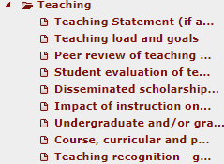
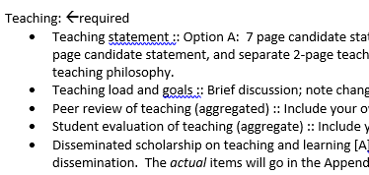
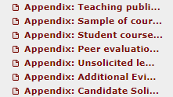
Notes:
✓ Teaching Statement (if applicable) → only if using a 5-page Candidate Statement
✓ Teaching load and goals
✓ Peer review of teaching (aggregated)
✓ Student evaluation of teaching (aggregated)
✓ Disseminated scholarship on teaching and learning
✓ Impact of instruction on student learning outcomes
✓ Course, curricular, and professional development
✓ Teaching recognition-grants, awards, honors, fellowships

Slide 43
All the raw material:
Actual course evaluations
Actual peer evaluations
Articles, presentations, and papers*
Course materials (syllabi and assignments)
Consult with your school about what is expected
Campus does not use these
Can create hyperlinks from regular sections to this
NO GIANT PDFS : Provide tables of content and other guides for readers
*Consider using
IUPUI ScholarWorks
for these materials: makes them accessible to external reviewers.
Appendices
Notes:
✓ Appendix: Teaching publications
✓ Appendix: Sample of course materials
✓ Appendix: Student course evaluations
✓ Appendix: Peer evaluations
✓ Appendix: Unsolicited letters from former students
✓ Appendix: Additional Evidence

Slide 44
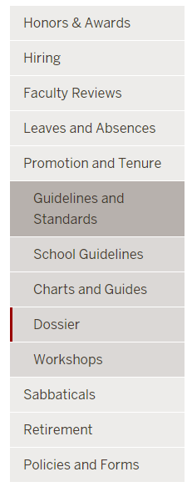
Assistance
To be a good teacher: theforum.iupui.edu
School and program-specific advice
Your school chairs, deans or P&T committee
OAA will do school or department-specific workshops
CTL: Teaching Philosophy statement
Sample dossiers
Also check with your program

Slide 45
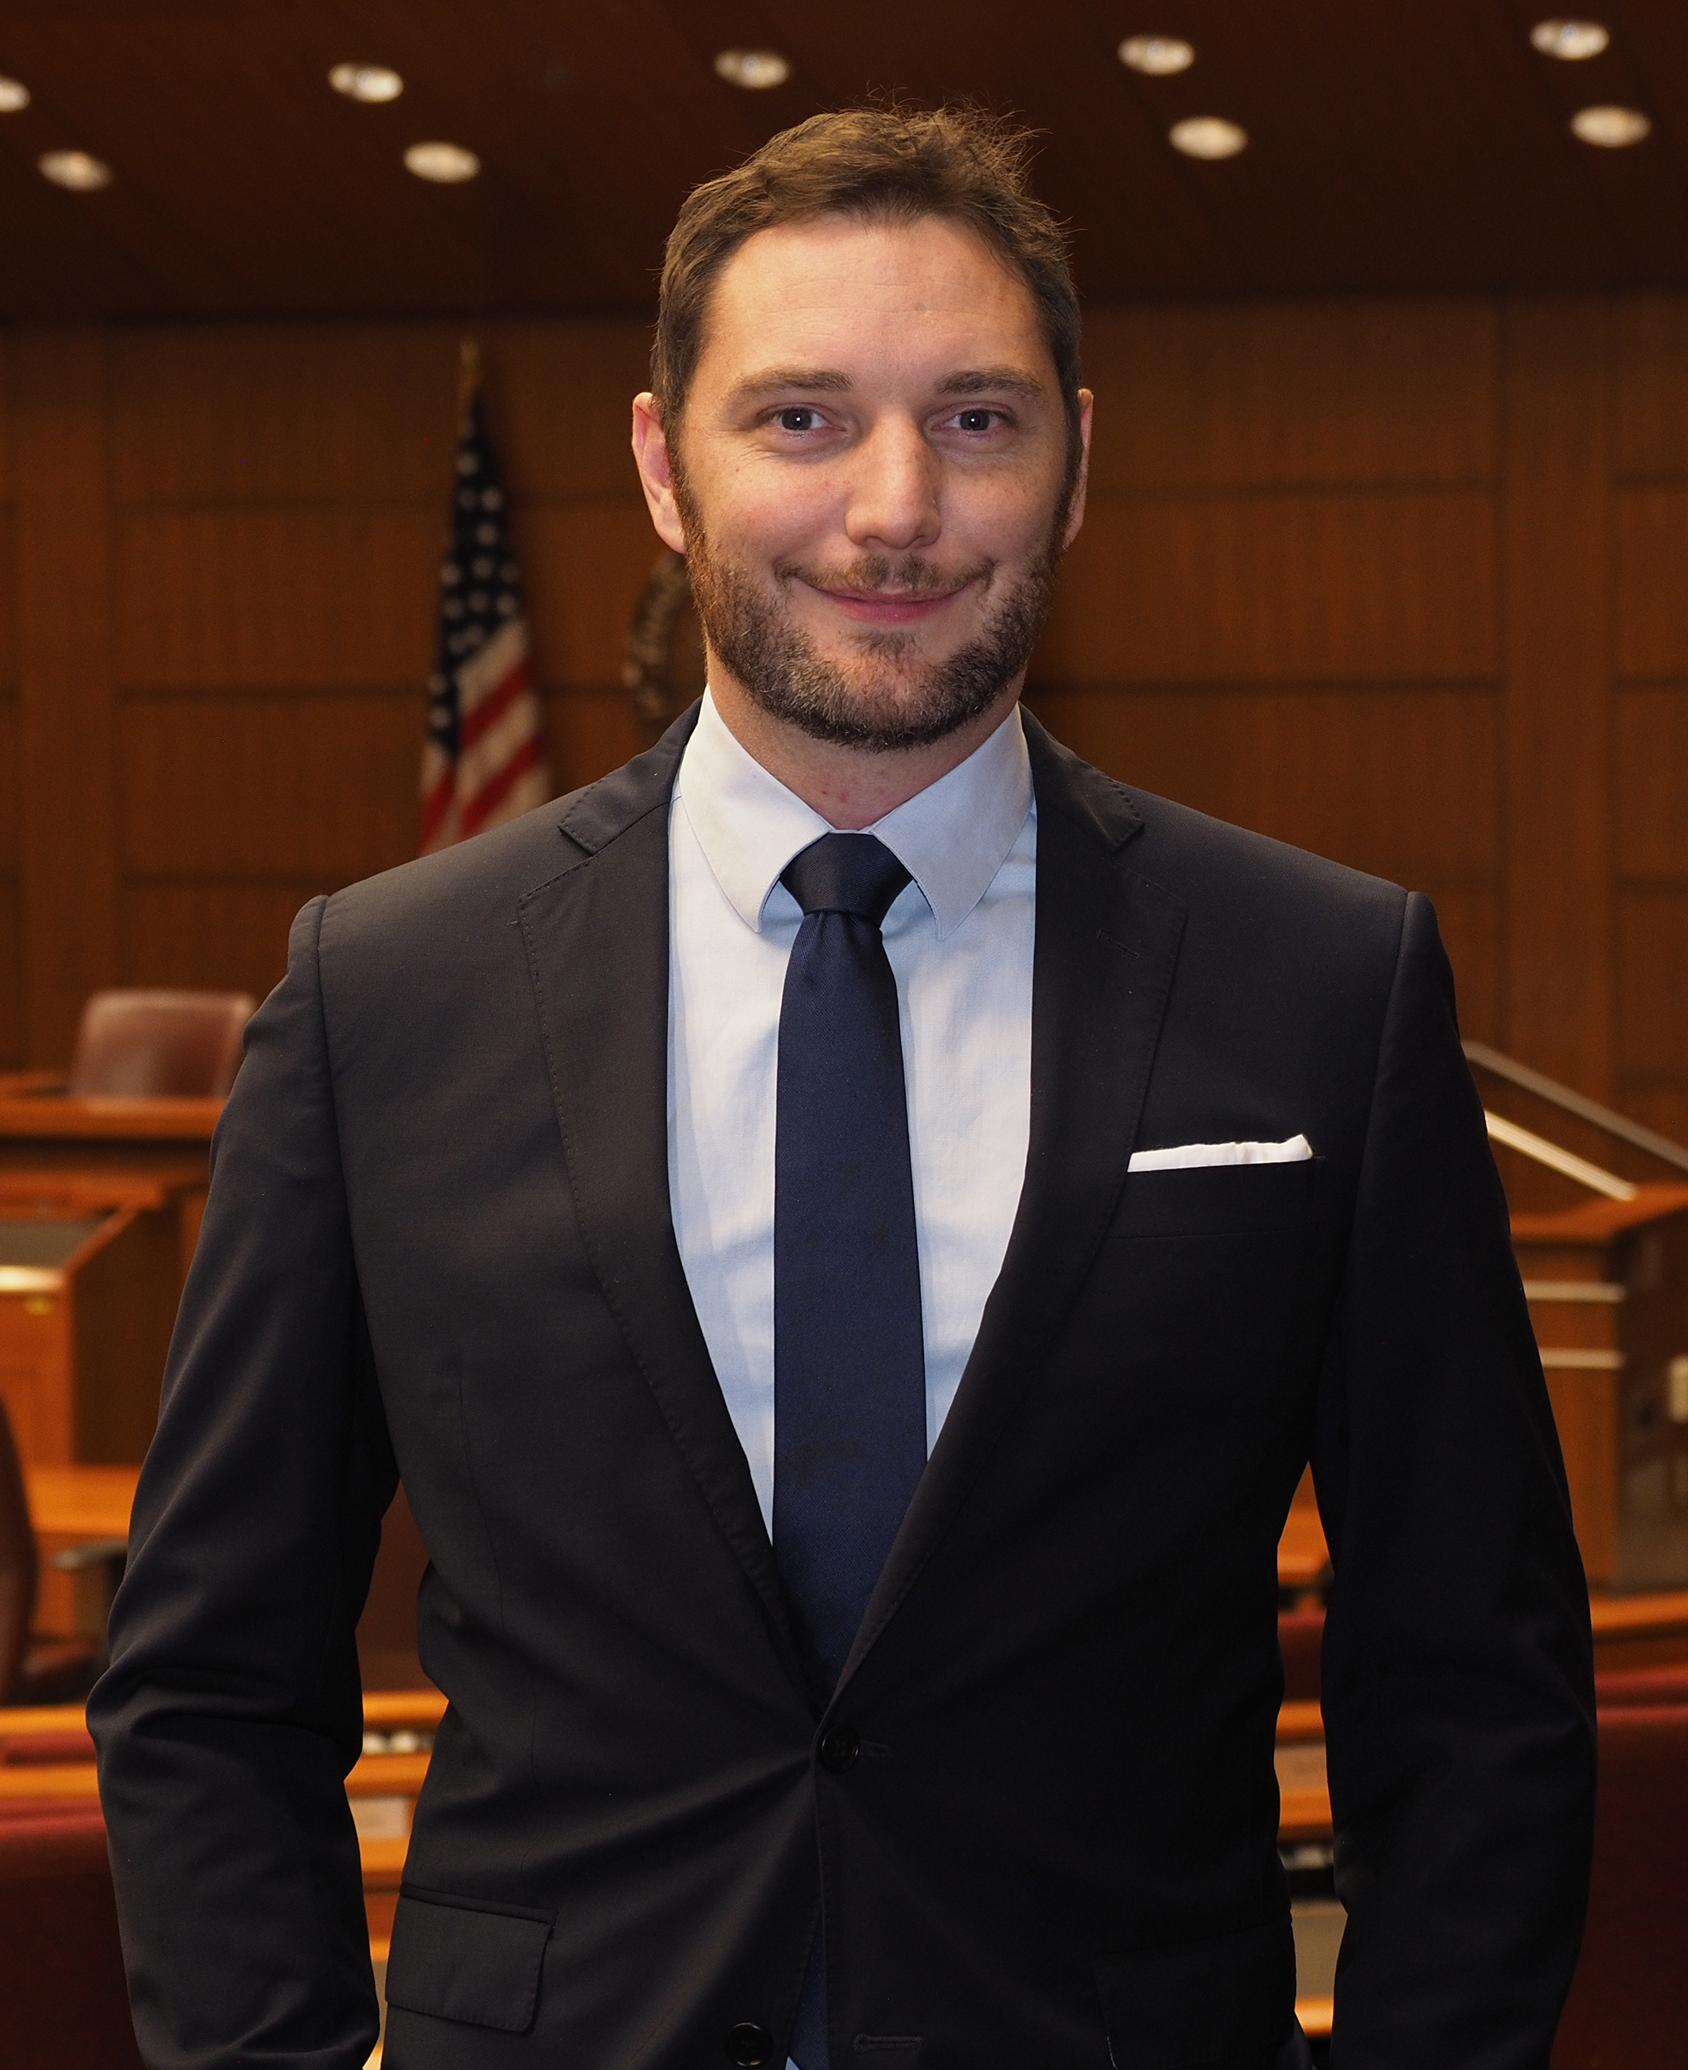
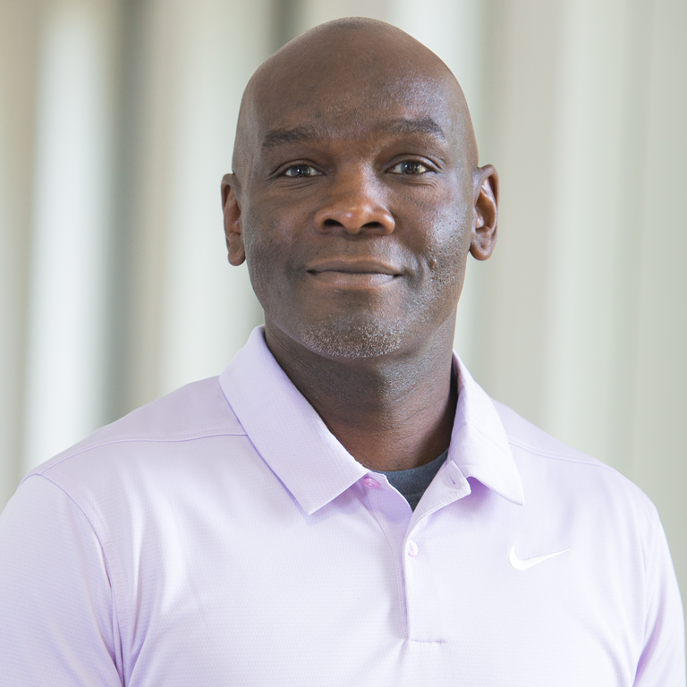
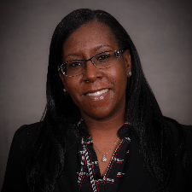
Helpful Guides
Brad Desnoyer Clinical Professor of Law
McKinney School of Law
Darrell Nickolson Clinical Associate Professor of Architectural Technology
School of Engineering & Technology
Shotunus Peterson
Clinical Associate Professor, Field Instruction and Coordination
School of Social Work (IUSB)
Notes:
Brad: Track everything using your Annual Review. Makes it easier to remember things when you go up for promotion. Being involved in a professional organization is helpful with dissemination and relating to non-clinical faculty.
Darrell: Have someone proofread your writing. When getting feedback on your content, remember that it is your case.
Shotonus: Allow yourself plenty of time to get a draft done, get feedback, and revise your dossier. If you are teaching outside of the classroom, track all of your student contact like orientations or mentoring roles. Have someone outside of your field review your writing.

Slide 46
Willie Miller
Faculty Advancement and Leadership Development Fellow
wmmiller@iupui.edu
Rachel Applegate
Assistant Vice Chancellor for Faculty Affairs
rapplega@iupui.edu
Margie Ferguson
Senior Associate Vice Chancellor for Academic Affairs
mferguso@iupui.edu

